Slide 1
Scrum

Slide 2
Agenda
Scrum Overview
Scrum Team
Scrum Sprints
DevOps
SAFe

Slide 3
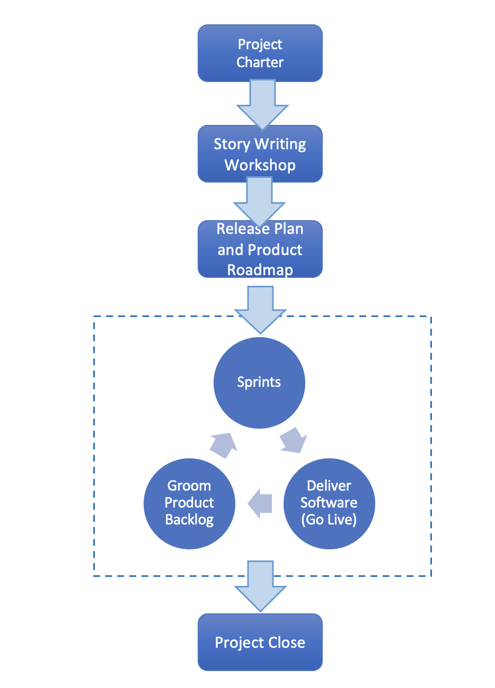
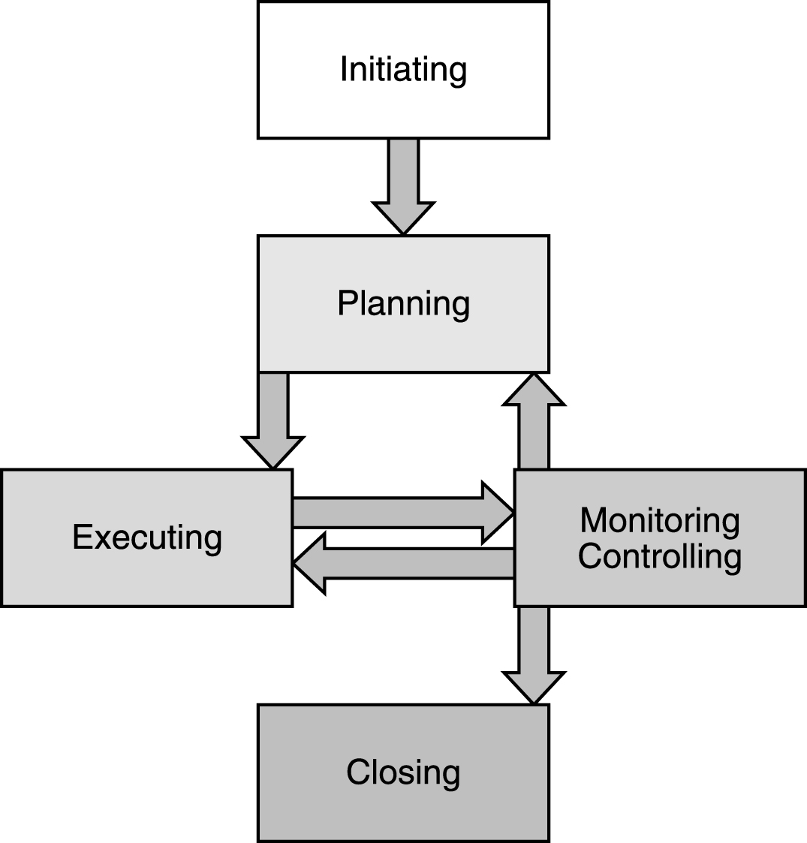
Understanding the Project Lifecycle
Planned – PMBOK
Adaptive - Scrum/Agile
PMP in Depth: Project Management Professional Study Guide for PMP and CAPM Exams

Slide 4
Scrum Flow
Project Charter
Business case, high level project scope, major milestones, product vision
Story Writing
User Story Development and Story Writing Workshops
Release Plan and Product Roadmap
Product backlog grooming
Sprint Execution
Multiple iterations
Release Software
Deploy software to operational environment
Project Close

Slide 5
Scrum Approach
Customer focused
Timeboxed (Iterative)
Embrace Change and Uncertainty

Slide 6
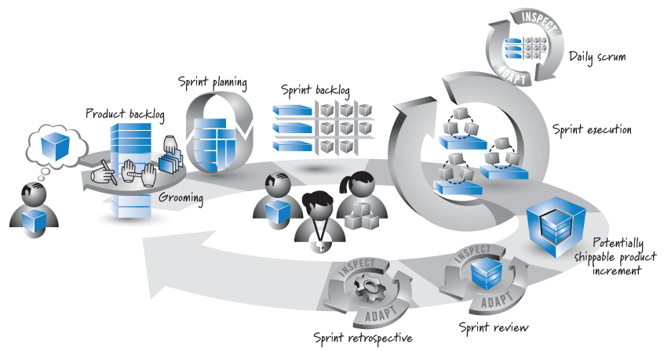
Sprint Overview
Source: Essential Scrum by Kenneth S. Rubin p. 17

Slide 7
Scrum Team

Slide 8
Product Owner
Central Point of Product Leadership
Manage product economics
Cost benefit analysis of product backlog
Groom the product backlog
Prioritize product backlog requests
Define acceptance criteria
Collaborate with the development team
Frequent communication
Collaborate with stakeholders
Primary interface with all external stakeholders who have an interest in the product
Voice of the customer
Source: Essential Scrum by Kenneth S. Rubin

Slide 9
Scrum Master
Helps everyone involved understand Scrum values, principles and practices
Coach
Servant leader
Process authority
Impediment remover
Source: Essential Scrum by Kenneth S. Rubin

Slide 10
Development Team
Responsible for performing the development work
Self organizing and the team decides the best approach
No project manager to direct the team on how to perform the work
Cross-functional Skills
Diverse range of skills
T-shaped skills
Deep knowledge in one area and shallow knowledge in many areas
Musketeer attitude
All for one and one for all
Right sized
5 to 9 team members
Communication
Transparent and high bandwidth
Source: Essential Scrum by Kenneth S. Rubin

Slide 11
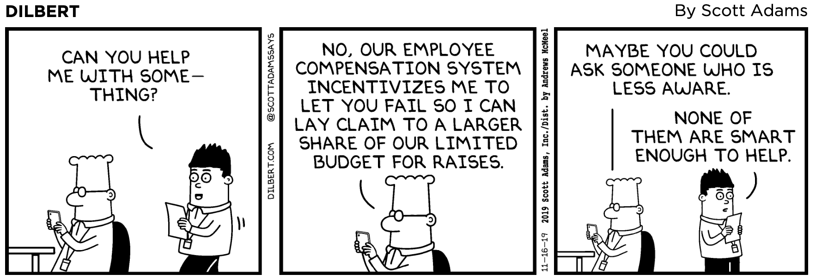

Slide 12
Scrum Activities

Slide 13
Sprint
A sprint is a short duration development activity resulting in something of tangible value to the customer or user
Timeboxed lasting between 1 week to 30 days
Fixed scope - Goal altering changes are not allowed
Central development unit around which much of the scrum planning process takes place
Source: Essential Scrum by Kenneth S. Rubin

Slide 14
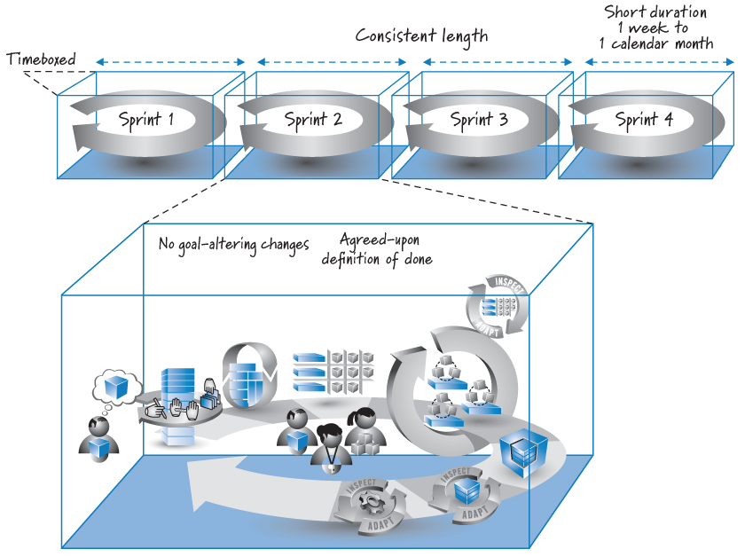
Sprint
Source: Essential Scrum by Kenneth S. Rubin p. 41

Slide 15
Sprint Planning
Establishes the content for the next sprint
During sprint planning, the product owner and development team agree upon a sprint goal that defines what the upcoming sprint is supposed to achieve
Review product backlog to determine high priority items that can be accomplished in the upcoming sprint
Features are broken out into sets of tasks
Referred to as a sprint backlog
An estimate of the effort required to complete each is provided
Spring planning is typically performed in 4 to 8 hours
Derived from the Product Backlog that may contain weeks or months of work
Source: Essential Scrum by Kenneth S. Rubin

Slide 16
Sprint Execution
Development team performs all of the task-level work necessary to get the features done
Development team self organizes in any manner to achieve sprint goal
Daily scrum
What did I accomplish since the last daily scrum
What do I plan to work on by the next daily scrum
What are the obstacles or impediments that are preventing me from making progress
Source: Essential Scrum by Kenneth S. Rubin

Slide 17
Sprint Done
A potentially shippable product increment
A complete slice of product functionality, on the has been designed, built, integrated, tested, and documented and would deliver validated customer value
Definition of Done Varies Depending on
The nature of the product being built
The technologies being used to build it
The organization that is building it
The current impediments that affect what is possible
Useful to have a Checklist
Source: Essential Scrum by Kenneth S. Rubin
Notes:
Checklist items - Design reviewed, code completed, end user documentation updated, tested, zero know defects, acceptance tested, Live on production server

Slide 18
Sprint Review
The goal is to inspect and adapt the product that is being built
Focus on reviewing the just completed features in the context of the overall development effort
Communication intensive activity among all stakeholders
Source: Essential Scrum by Kenneth S. Rubin

Slide 19
Sprint Retrospective
Focus on the scrum process and process improvement
Development team, product owner, and scrum master come together to discuss what is working and not working
Source: Essential Scrum by Kenneth S. Rubin

Slide 20
Scrum Flow
Project Charter
Business case, high level project scope, major milestones, product vision
User Story Development
Story writing workshops
Product Roadmap and Release Plan
Product backlog grooming
Sprint Execution
Multiple iterations
Release Software
Deploy software to operational environment
Project Close

Slide 21
DevOps

Slide 22
DevOps
DevOps
Contraction of Development and Operations
Once working software has been developed, need to release the software into production
Integration testing
Scale to meet projected demand
Deploy to production operational environment
DevOps refers to the process of releasing into production the work completed by the development team
Emphasizes continuous delivery rather than phased delivery
Ensures quality
Reduces time to rollout new features
Continuous deployment

Slide 23
Azure Devops
Boards
Kanban board for tracking to do, in progress and complete
Based on Scrum and includes sprint planning and product backlog grooming
Pipelines
Automates deployment of new code to production environment
Continuous integration/continuous delivery
Repos
Code repository used to store source code
GitHub
Includes version control
Test Plans
Automatically execute tests on new software revisions
Artifacts
Fully integrated 3rd party package management
Connect with 3rd party libraries and package repositories (npm Node.js, Python, etc.)

Slide 24
Devops Video
https://azure.microsoft.com/en-us/blog/introducing-azure-devops/

Slide 25
SAFe

Slide 26
SAFe
Scaled Agile Framework
End to end methodology for scaling Scrum across the Enterprise
Promotes and encourages business alignment
Integrates DevOps with Development

Slide 27
Built Around Five Core Competencies
Lean Agile Leadership
Team and Technical Agility
DevOps and Release on Demand
Business Solutions and Lean Systems Engineering
Lean Portfolio Management

Slide 28
Four Primary Versions of SAFe
Essential SAFe
Works well for small to medium sized project
Aligns DevOps and Scrum
Large Solution SAFe
Designed to be used for large, complex projects
Portfolio SAFe
Used when alignment of multiple projects is required
Full SAFe
Supports use of agile and Scrum across the enterprise

Slide 29
SAFe
Scaled Agile
https://www.youtube.com/watch?v=8IYFTSCoBjg&feature=youtu.be.

